Slide 1
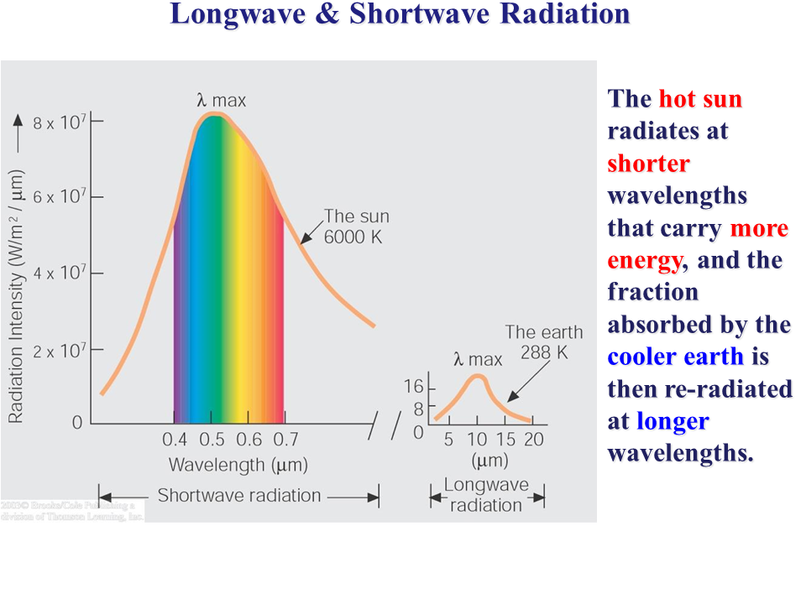
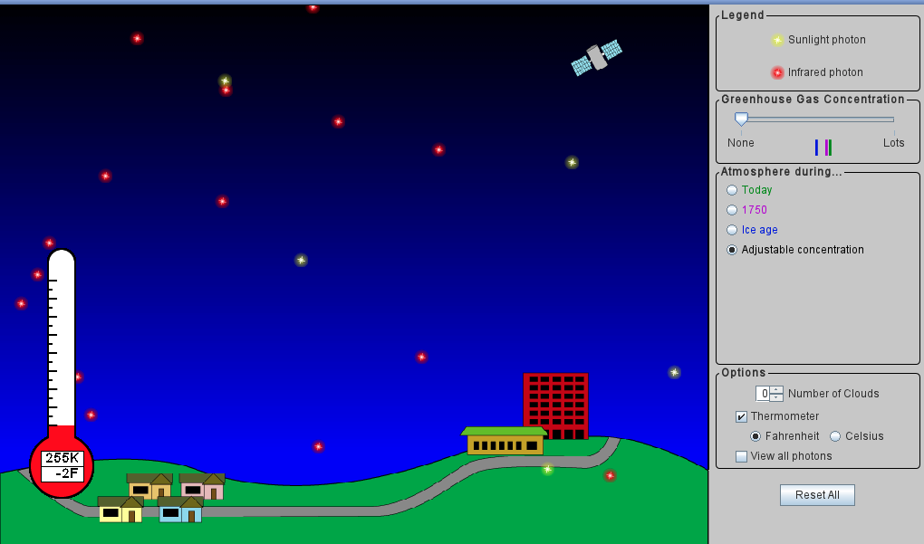
PhET simulation – shortwave radiation
Yellow photons represent shortwave radiation from the sun.
https://phet.colorado.edu/sims/cheerpj/greenhouse/latest/greenhouse.html?simulation=greenhouse
https://www.sliderbase.com/spitem-1155-2.html

Slide 2
PhET simulation – shortwave radiation
Visible part of shortwave
https://phet.colorado.edu/sims/cheerpj/greenhouse/latest/greenhouse.html?simulation=greenhouse
https://www.sliderbase.com/spitem-1155-2.html

Slide 3
PhET simulation – shortwave radiation
Visible part of shortwave
Near infrared
https://phet.colorado.edu/sims/cheerpj/greenhouse/latest/greenhouse.html?simulation=greenhouse
https://www.sliderbase.com/spitem-1155-2.html

Slide 4
PhET simulation – shortwave radiation
Visible part of shortwave
Near infrared
ultraviolet
https://phet.colorado.edu/sims/cheerpj/greenhouse/latest/greenhouse.html?simulation=greenhouse
https://www.sliderbase.com/spitem-1155-2.html

Slide 5
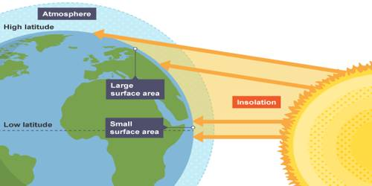
PhET simulation – shortwave radiation
The intensity of shortwave light reaching every square meter of Earth’s surface depends on where you are on the planet. The excess at the equator is the main driver of weather & climate.
>2x on average!
https://phet.colorado.edu/sims/cheerpj/greenhouse/latest/greenhouse.html?simulation=greenhouse
http://earthshinefoundation.org/images/whatisearthshine.jpg

Slide 6
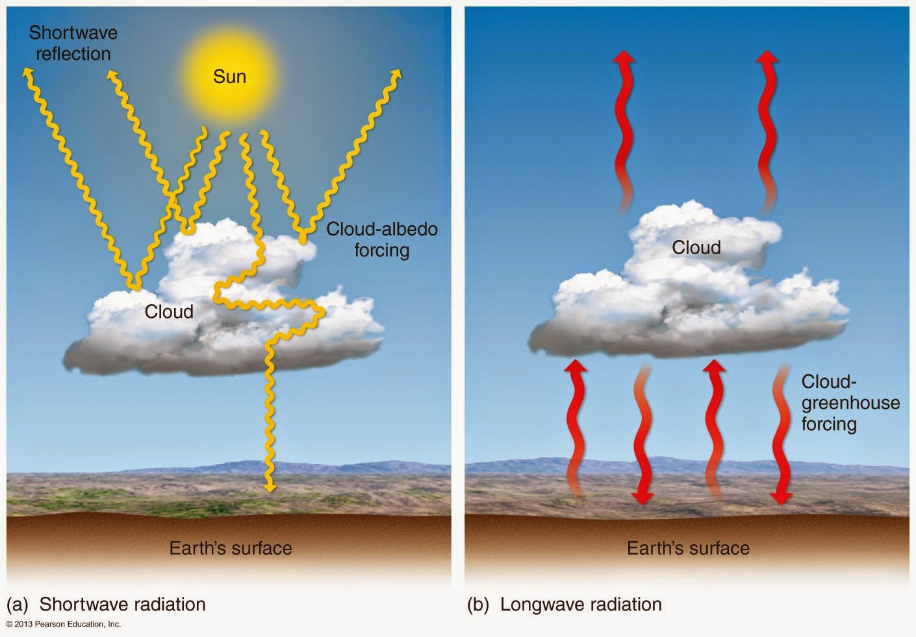
PhET simulation – shortwave radiation
Another driver: the amount of shortwave energy reflected by Earth. That reflectivity (called the albedo) is a lot bigger where there are clouds and highly reflective ground cover (like ice and snow).
https://phet.colorado.edu/sims/cheerpj/greenhouse/latest/greenhouse.html?simulation=greenhouse

Slide 7
PhET simulation – longwave radiation
Red photons represent longwave radiation emitted by Earth’s surface (also emitted by the atmosphere, your hands, any solid object). Each longwave photon packs less energy than a shortwave photon, so you’ll see more of them in the PhET simulation.
Visible
uv
Near IR
https://phet.colorado.edu/sims/cheerpj/greenhouse/latest/greenhouse.html?simulation=greenhouse

Slide 8
PhET simulation – longwave radiation
The intensity of the longwave light emitted by an object depends on:
The temperature of the object
Temperature of the atmosphere
It also matters how easily photons get past the atmosphere and out to space
https://phet.colorado.edu/sims/cheerpj/greenhouse/latest/greenhouse.html?simulation=greenhouse

Slide 9
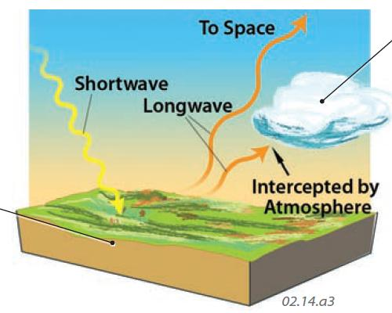
Shortwave and longwave
https://geography.name/wp-content/uploads/2019/06/22.jpg

Slide 10
Net radiative flux is the balance between shortwave (incoming) and longwave (outgoing)
Net radiative flux is zero, so Earth is in radiative balance.
https://phet.colorado.edu/sims/cheerpj/greenhouse/latest/greenhouse.html?simulation=greenhouse

Slide 11
Net radiative flux is the balance between shortwave (incoming) and longwave (outgoing)
Earth is too cold, so net radiative flux is positive. Earth will heat up!
https://phet.colorado.edu/sims/cheerpj/greenhouse/latest/greenhouse.html?simulation=greenhouse

Slide 12
Net radiative flux is the balance between shortwave (incoming) and longwave (outgoing)
Earth is too hot, so net radiative flux is negative. Earth will cool down!
https://phet.colorado.edu/sims/cheerpj/greenhouse/latest/greenhouse.html?simulation=greenhouse

Slide 13
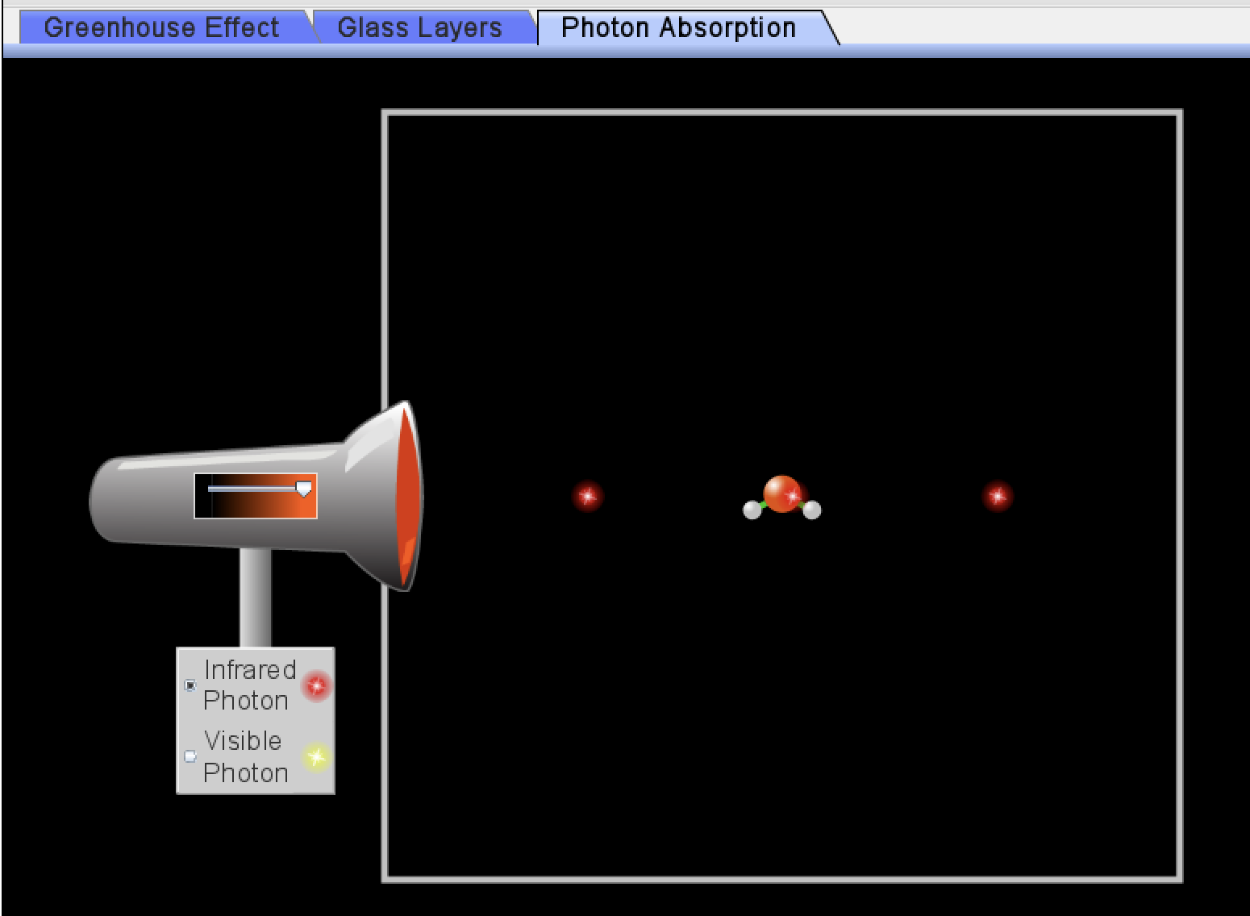
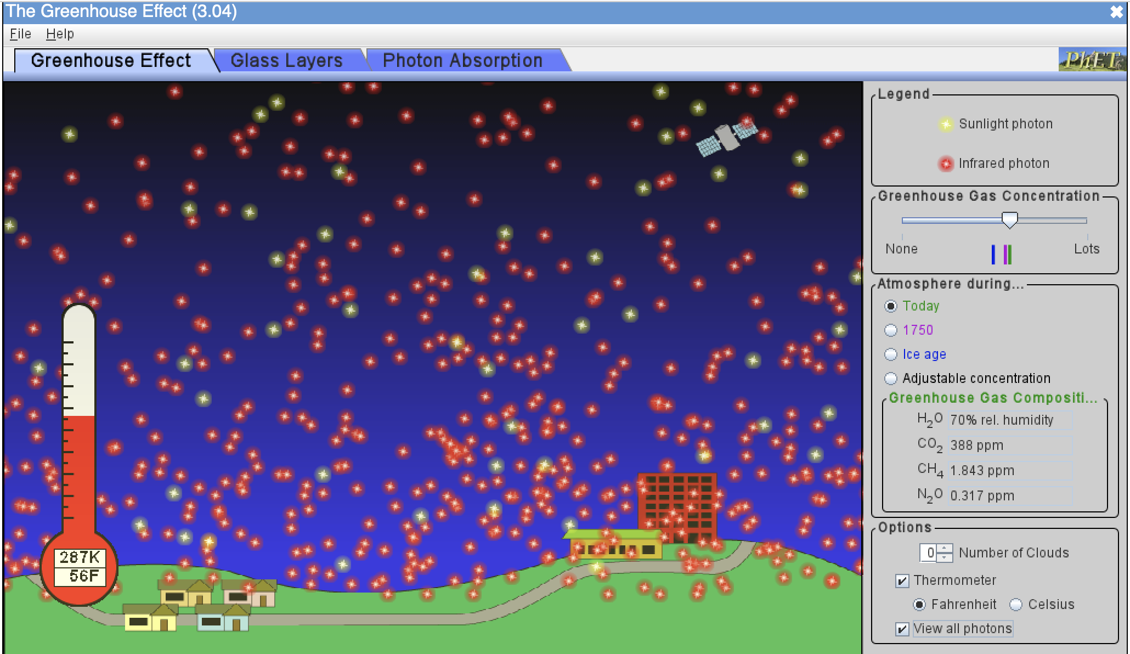
OK, let’s get started … jotting down answers to these questions in your research notebook
What kind of light (SW or LW) do GHG molecules absorb?
What happens to those molecules when they absorb that light?
Assuming radiative balance, why are there more LW photons leaving Earth than SW photons coming in?
What seems to be the homeostatic temperature (in degrees K, C, F) with default settings?
How much colder was it back in 1750 compared to now?
How much colder was it during ice ages compared to now?
What effect do clouds have on SW photons?
On LW photons?
On temperature?
https://phet.colorado.edu/sims/cheerpj/greenhouse/latest/greenhouse.html?simulation=greenhouse

